Slide 1
CampusPulse: A WIFI BSSID Based GeoLocation Attendance
CSE7302- University Project
Review-5
Batch Number:COM_32
Roll Number | Student Name
20221COM0152 | Hrishikesh Vivekanand Ghodke
20221COM0185 | Ravi Ranjan
20221COM0192 | Sumith Kumar V
Under the Supervision of,
Dr. Asha Hegde
Assistant Professor
School of Computer Science and Engineering
Presidency University
Name of the Program: B.Tech(COM)
Name of the HoD: Dr. Gopal Krishna Shyam
Name of the Program Project Coordinator: Mrs Sumita Guddin
Name of the School Project Coordinator: Dr. Sampath A K

Slide 2
Abstract
Attendance management in educational institutions and corporate organizations requires accuracy, security, and scalability. Traditional methods such as manual roll calls, biometric devices, and GPS-based mobile systems are prone to proxy attendance, indoor inaccuracy, and location spoofing. To address these challenges, this project proposes a Geo-Location Based Attendance Marking System that combines Wi-Fi BSSID-based location verification, mock location detection, and device-level multi-factor authentication.
The system uses the Wi-Fi BSSID of connected access points to ensure accurate indoor and room-level presence validation, overcoming the limitations of GPS. Mock location detection prevents location spoofing, while user authentication is secured using device-provided biometrics with a PIN fallback, without storing biometric data. The solution includes an Android application for attendance marking, a web-based admin portal, and a FastAPI backend with PostgreSQL, secured using HTTPS and JWT authentication. The proposed system is secure, scalable, cost-effective, and suitable for real-world deployment in educational and corporate environments.

Slide 3
Objectives
• Algorithm Details
Results

Slide 4
Problem Statement
Traditional attendance systems suffer from proxy attendance, GPS spoofing, indoor inaccuracy, and high hardware costs. A secure, indoor-accurate, and hardware-independent attendance solution is required.

Slide 5
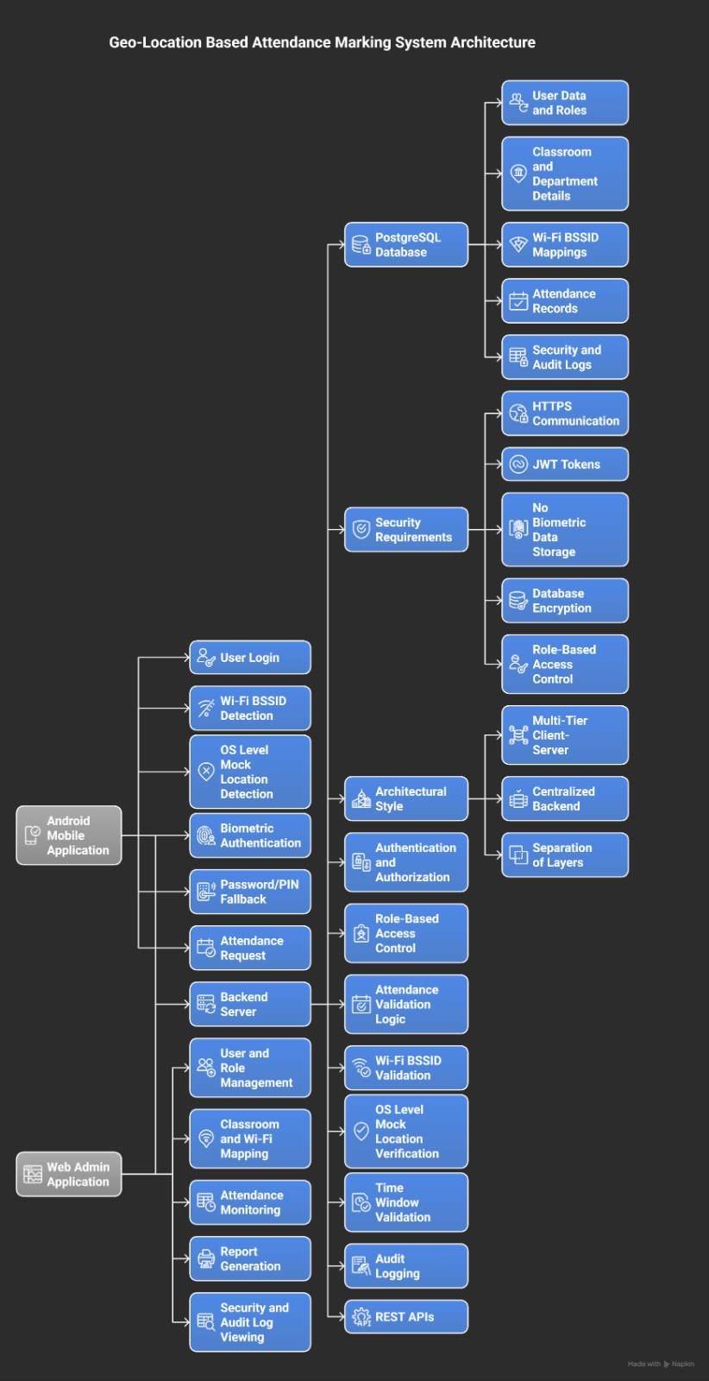
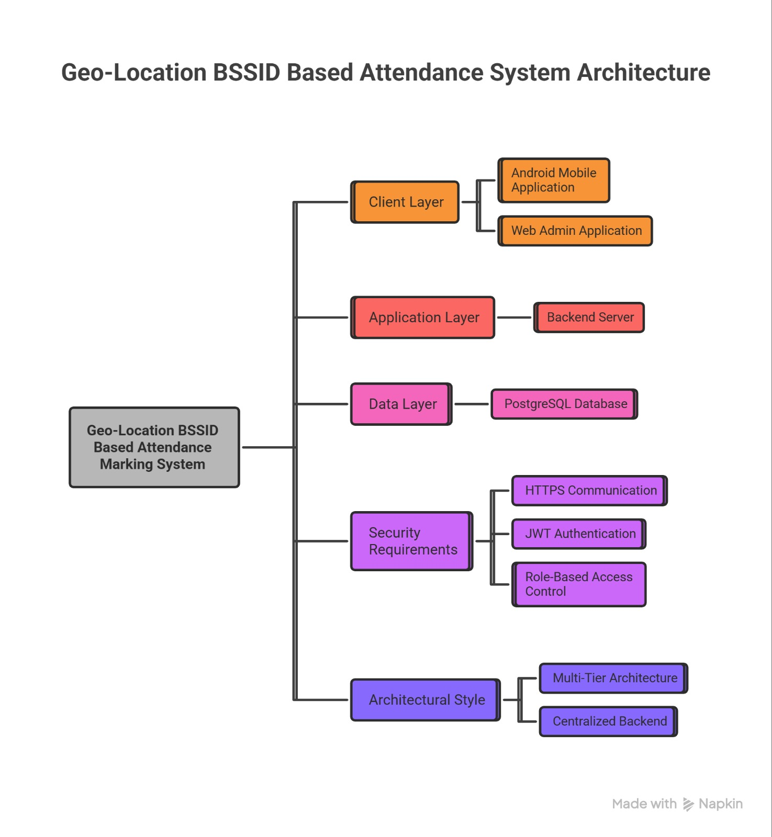
Architecture Diagram

Slide 6
main.py
Purpose:
Initialize FastAPI app
Register routers
Configure middleware / CORS
Request handling algorithm (high‑level):
Receive HTTP request
Route to specific router based on path
Run dependencies (DB session, auth, etc.)
Execute endpoint logic
Serialize response and return

Slide 7
config.py
Purpose:
Load settings (DB URL, secrets, env config)
Configuration loading algorithm:
Read environment variables / .env
Validate required keys
Build config object
Expose config to rest of app

Slide 8
database.py
Purpose:
Create engine and session factory
DB session lifecycle algorithm:
Build DB engine from config
On request, create Session
Pass Session into endpoint via dependency
Commit / rollback on success/failure
Close session

Slide 9
models.py
Purpose:
Define ORM models (User, Classroom, Attendance, Wifi, etc.)
Model mapping algorithm:
Map Python classes → DB tables (columns, PK/FK)
Relate entities (User–Attendance, Classroom–Attendance, etc.)
Lifecycle:
Create model instance
Add to session
Commit → row in DB
Query → model instances returned

Slide 10
schemas.py
Purpose:
Acts as digital forms for User, Classroom, WiFi, and Attendance data
Checks that information coming from the app is reasonable
Controls what information is sent back (hides sensitive data like passwords)
Algorithm:
App sends data to the backend
Match it to the correct form (user, classroom, WiFi, attendance)
For each field, check:
Is it present when required?
Is text not too short/long?
Are numbers positive?
Are time and date fields in a valid format?
If something is wrong → return a clear error message
If everything is fine → pass clean data to the database logic and send back only safe fields in a tidy format

Slide 11
users.py
Purpose:
CRUD users, login, profile, etc.
Key endpoints:
Register user
Login
Get current user
(example algorithm: Register user):
Receive registration data schema
Validate (email uniqueness, password rules)
Hash password
Create User model
Persist to DB
Return user schema (without password)
(example algorithm: Login):
Receive credentials
Find user in DB
Verify password hash
If OK, generate token
Return token + user info

Slide 12
classrooms.py
Purpose:
Manage classrooms and their geo boundaries
Key algorithms (one bullet per endpoint):
Create/update classroom:
Receive classroom data (name, coordinates/zone)
Validate coordinates / format
Save to DB
List classrooms:
Query DB
Filter by teacher/user if needed
Return list schema

Slide 13
attendance.py
Purpose:
Mark/check attendance based on geo (and possibly Wi‑Fi)
Typical endpoints:
Mark attendance
Get attendance for user/classroom/date
(Get attendance algorithm):
Authenticate requester (teacher/admin)
Read filters (classroom, date, user)
Build DB query with filters
Execute query
Map results to response schemas
Return list of attendance records
(Mark attendance algorithm):
Authenticate user (via security dependency)
Receive location/Wi‑Fi info and classroom reference
Start DB session
Validate:
Time window (within allowed schedule)
Position/Wi‑Fi corresponds to classroom
If valid:
Create Attendance record (user, classroom, timestamp, method)
Commit
Return success + attendance details
If invalid: return error describing reason

Slide 14
wifi.py
Purpose:
Use Wi‑Fi BSSIDs/SSIDs to infer classroom/location
Wi‑Fi matching algorithm (typical):
Receive list of observed access points (BSSID, RSSI)
Compare with stored classroom Wi‑Fi signatures
Compute similarity score (e.g. count of matching BSSIDs)
Pick best matching classroom above threshold
Return inferred classroom or error

Slide 15
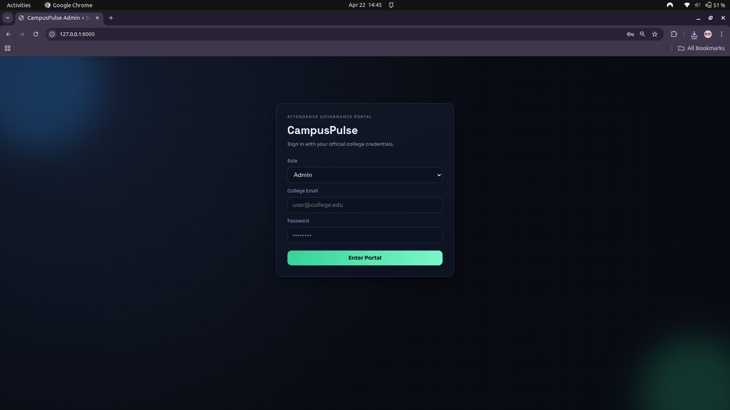
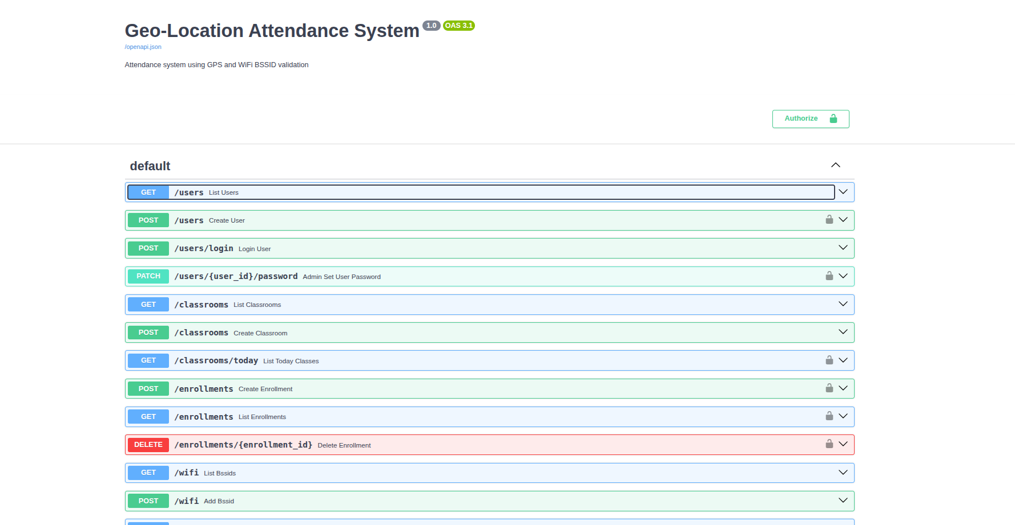
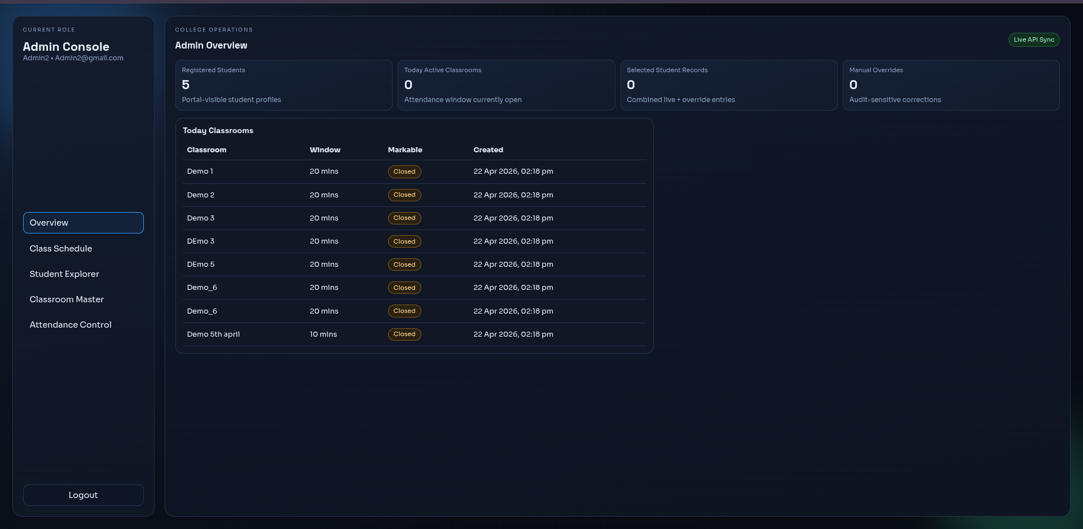
Results

Slide 16
Git Hub Link
LINK:
CampusPulse: A WIFI BSSID Based GeoLocation Attendance

Slide 17


